Slide 1


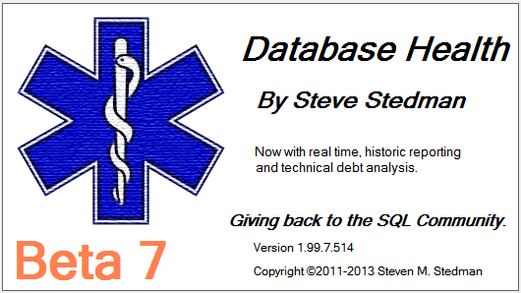
Introduction to Common Table Expressions
Presented by Steve Stedman

Slide 2
About the Speaker/Author (Steve Stedman)
Working at Emergency Reporting as CTO
Joes2Pros
Author of the Common Table Expression Book
Instructor at the Joes2Pros Academy
23 Years of database work (Microsoft 1990-1991)
Developer of the Database Health Application
http://DatabaseHealth.com
Volunteer Firefighter and EMT
Twitter: @SqlEmt
Website: http://SteveStedman.com

Slide 3
Downloadable Content
This presentation and all samples are available at:
http://SteveStedman.com

Slide 4
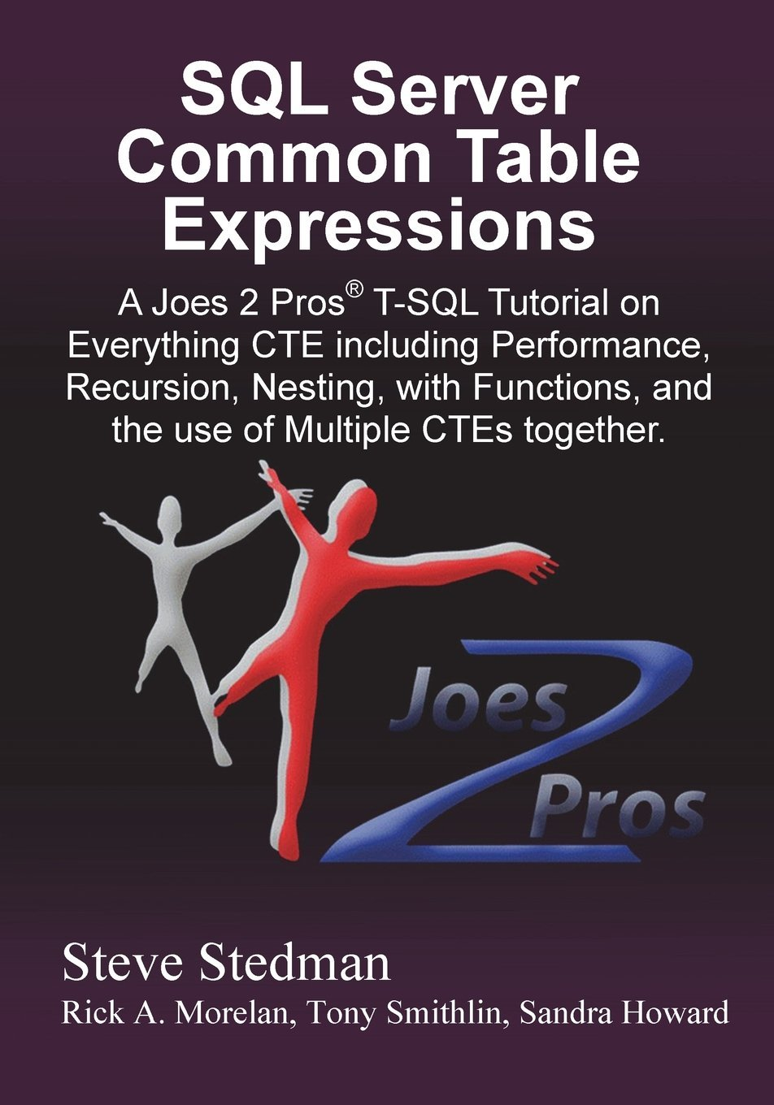
Common Table Expressions Book
Published May 2013
Available at Amazon.com and at Joes2Pros.com
Print and Kindle versions both available.
Today’s topic comes from Chapter 1, 2, 3, 4, 6, 7 and 9
of
SQL Server Common Table Expression

Slide 5
Audience Survey
How many people:
have heard of CTEs?
have used CTEs?
have used recursive CTEs?
use CTEs every day?
How many people are planning on taking the 70-461 Microsoft Exam

Slide 6
CTE – Benefits coming your way!
Introduction to Memory Tables and CTEs
Simple CTE
CTE Instead of a Derived Table
Multiple CTE in a Query
Data Paging
CTEs in Stored Procedures, Functions and Views
Introduction To Recursive CTEs

Slide 7
Introduction to Memory Tables and CTEs
Chapter 1 and 2

Slide 8
Memory Tables
SELECT *
FROM (SELECT id,
department,
parent
FROM Departments) as Dept;
Virtual Tables
Derived Table
Sub query
Views
Temporary Named Result Set
Temp Tables
Table Variables
Common Table Expressions
CREATE VIEW [dbo].[DeptView]
AS
SELECT id, department, parent
FROM Departments;
GO
SELECT q1.department,
q2.department AS subDept
FROM DeptView q1
INNER JOIN DeptView q2
ON q1.id = q2.parent
WHERE q1.parent IS NULL;
CREATE TABLE #deptTempTable (
id int,
department VARCHAR (200),
parent int
);
DECLARE @deptTableVariable TABLE(
id int,
department VARCHAR (200),
parent int
);

Slide 9
What is a CTE
A type of a virtual table
Similar to the ease of a temporary table
Sort of like a derived table
Like a temporary named result set
Acts like a temporary view, or a run time view

Slide 10



Availability of CTEs
TRANSACT SQL feature that I wish I had learned about 8 years ago, CTE’s were introduced in SQL Server 2005
All versions of SQL Server since SQL 2005 and all variations of SQL Server support CTEs
CTEs are available in SQL Azure

Slide 11
Why Use Common Table Expressions?
Simplify your query – test one part at a time
Recursion
Computer Science: When a function calls itself
SQL Server: When a query calls itself
Make derived table queries more readable
Alternative to a temp table or a table variable

Slide 12
CTE Syntax - WITH
Queries start with WITH not SELECT
Can be confusing if you are assuming that any query to select data would start with a SELECT
The scope of the CTE is confined to a single query
A CTE just seems a little weird, until you master the syntax

Slide 13
Simple CTE Syntax
;WITH expression_name [(column_name[,...n])]
AS
(
CTE_query_definition
)
SELECT <column_list>
FROM expression_name;

Slide 14
Simple CTE
Demo

Slide 15
Reminder
If a CTE is not the first statement in a batch it must be proceeded with a semicolon

Slide 16
CTEs Instead of Derived Tables
Chapter 3

Slide 17
CTE Instead of a Derived Table
Simplifies the query – allows for clean code
Does not improve the performance
More value for large derived table queries in that the TSQL is cleaner and easier to read and understand
Eliminates accidents by duplicating derived table queries TSQL code

Slide 18
Derived Table Without a CTE
SELECT q1.department, q2.department
FROM (SELECT id, department, parent
FROM Departments) AS q1
INNER JOIN (SELECT id, department, parent
FROM Departments) AS q2
ON q1.id = q2.parent
WHERE q1.parent IS NULL;

Slide 19
Steps to Convert a Derived Table to a CTE
Find the first occurrence of the derived table query to be broken out. Create a name for it and add “CTE” to the name.
Copy the derived table definition, including the parentheses, and leave the new name as the placeholder.
Paste the query, copied earlier, above the SELECT statement.
At the top of the query add the CTE declaration using the same name from step 1.
Find all other occurrences of the same derived table query and replace them with the CTE name.
Clean up the formatting and test the query.

Slide 20
CTE for Derived Table Re-use
;WITH deptCTE (id, department, parent) AS
(SELECT id, department, parent
FROM Departments)
SELECT q1.department, q2.department
FROM deptCTE q1
INNER JOIN deptCTE q2 on q1.id = q2.parent
WHERE q1.parent is null;

Slide 21
Chapter 3
Demo

Slide 22
CTE Instead of a Derived Table Summary
Most derived tables can be easily converted to a CTE
Copy and paste errors can be reduced by using a CTE
Using a CTE doesn’t improve the performance over a similar query written with derived tables
For a CTE that is referenced multiple times the CTE query is not reused, it is executed multiple times

Slide 23
Multiple CTEs in a Query
Chapter 6

Slide 24
Multiple CTE’s In A Single Query
You can include multiple CTE's by comma seperating them:
;WITH firstCTE AS
(query goes here)
,secondCTE AS
(second query goes here)
SELECT * FROM firstCTE
INNER JOIN secondCTE on ...

Slide 25
Steps to add a Second CTE
Add a comma at the end of the first CTE, after the closing parentheses.
After the comma, on the next line, declare the name of the new CTE.
After the name of the new CTE add the optional columns declaration.
Add the AS keyword followed by opening and closing parentheses.
Inside of the parentheses add the new CTE query.
Call the CTE query from the outer SELECT statement.

Slide 26
Demo: Multiple CTE
;WITH Fnames (Name) AS
(
SELECT 'John' UNION SELECT 'Mary' UNION SELECT 'Bill'
)
, Lnames (Name) AS
(
SELECT 'Smith' UNION SELECT 'Gibb' UNION SELECT 'Jones'
)
SELECT F.Name FirstName, L.Name LastName
FROM Fnames F
CROSS JOIN Lnames AS L;

Slide 27

Nested CTE’s
Russian Dolls – матрёшки
Pronounced Ma-Trosh-Key.
A Nested CTE query can only reference itself or CTE queries declared earlier in the query.

Slide 28
Nested CTE Example
;WITH cte0 AS
(
SELECT 1 AS num
)
, cte1 AS
(
SELECT num + 1 AS num
FROM cte0
)
, cte2 AS
(
SELECT num + 1 AS num
FROM cte1
)
SELECT *
FROM cte2;

Slide 29
Chapter 6
Demo

Slide 30
Data Paging With a CTE
Chapter 7

Slide 31
Data Paging
To achieve data paging without CTE it usually involves selecting TOP x, then TOP 2x then top 3x, each time taking longer and longer to get to the data that is needed.
Data paging can be simplified and not a challenge to create with CTE’s.
TSQL 2012 introduces the OFFSET and FETCH keywords which is easier to use than a CTE for data paging, and more efficient.

Slide 32
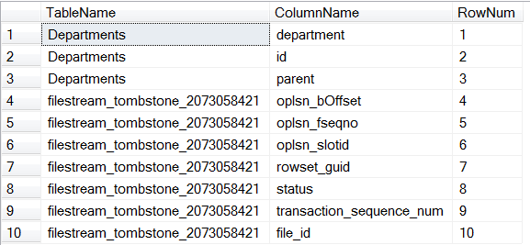
Data Paging Page 1

Slide 33
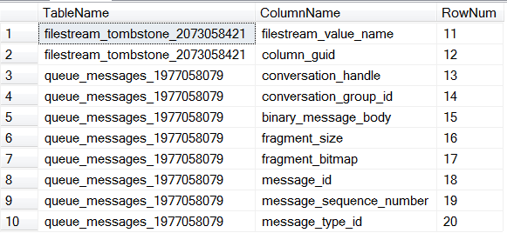
Data Paging Page 2

Slide 34
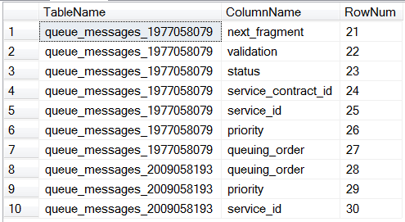
Data Paging Page 3

Slide 35
Demo: Data Paging
;WITH TablesAndColumns AS (
SELECT OBJECT_NAME(sc.object_id) AS TableName,
name AS ColumnName,
ROW_NUMBER()
OVER (ORDER BY object_name(sc.object_id))
AS Row
FROM sys.columns sc )
SELECT *
FROM TablesAndColumns
WHERE Row BETWEEN (@pageNum - 1) * @pageSize + 1
AND @pageNum * @pageSize ;

Slide 36
Demo: SQL Server 2012 Data Paging
SELECT OBJECT_NAME(sc.object_id) AS TableName,
name AS ColumnName
FROM sys.columns sc
ORDER BY TableName
OFFSET (@pageNum - 1) * @pageSize ROWS
FETCH NEXT @pageSize ROWS ONLY;
An alternative to CTE’s if you are using SQL Server 2012

Slide 37
Chapter 7
Demo

Slide 38
CTEs in Stored Procedures, Functions and Views
Chapter 9

Slide 39
CTEs in Stored Procedures, Functions and Views

Slide 40
Chapter 9
Demo

Slide 41
Introduction to Recursive CTEs
Chapter 4

Slide 42
4. Recursive CTE
Considered recursive when the CTE references itself
Recursion stops
When the recursive query produces no results
Or specify MAXRECURSION
Uses
Hierarchical listing of categories
Recursive calculations
Much, much more…

Slide 43
Recursion Overview
Sum the numbers from 1 to 10 without recursion
55 = 10 + 9 + 8 + 7 + 6 + 5 + 4 +3 + 2 + 1
Sum the numbers from 1 to 10 recursively
55 = 10 + (sum of numbers 1 to 9)
55 = 10 + (9 + (sum of numbers 1 to 8))
55 = 10 + (9 + (8 + (sum of numbers 1 to 7)))
Eventually we get to:
55 = 10 + (9 + (8 + (7 + (6 + (5 + (4 + (3 + (2 + 1))))))))

Slide 44
Recursive Terminology
Anchor Query
Start the recursion
One or more anchor queries
Recursive Query
The part that repeats
One or more recursive queries
MAXRECURSION
The number of times to repeat the recursive query
Default is 100
MAXRECURSION of 0 implies no maximum

Slide 45
Demo: Recursive CTE
;WITH DepartmentCTE(DeptId, Department, Parent, Lvl)
AS
Step 1. Declare the CTE and Columns

Slide 46
Demo: Recursive CTE
;WITH DepartmentCTE(DeptId, Department, Parent, Lvl)
AS
( SELECT id AS DeptId, Department, parent, 0 AS Lvl
FROM Departments
WHERE parent IS NULL
Step 2 – Add the Anchor Query

Slide 47
Demo: Recursive CTE
;WITH DepartmentCTE(DeptId, Department, Parent, Lvl)
AS
( SELECT id AS DeptId, Department, parent, 0 AS Lvl
FROM Departments
WHERE parent IS NULL
UNION ALL
Step 3 – Add the UNION ALL to connect to the recursive query

Slide 48
Demo: Recursive CTE
;WITH DepartmentCTE(DeptId, Department, Parent, Lvl)
AS
( SELECT id AS DeptId, Department, parent, 0 AS Lvl
FROM Departments
WHERE parent IS NULL
UNION ALL -- and now for the recursive part
SELECT d.id AS DeptId, d.Department, d.parent,
DepartmentCTE.Lvl + 1 AS Lvl
FROM Departments d
INNER JOIN DepartmentCTE
ON DepartmentCTE.DeptId = d.parent)
Step 4 – Add the recursive Query

Slide 49
Demo: Recursive CTE
;WITH DepartmentCTE(DeptId, Department, Parent, Lvl)
AS
( SELECT id AS DeptId, Department, parent, 0 AS Lvl
FROM Departments
WHERE parent IS NULL
UNION ALL -- and now for the recursive part
SELECT d.id AS DeptId, d.Department, d.parent,
DepartmentCTE.Lvl + 1 AS Lvl
FROM Departments d
INNER JOIN DepartmentCTE
ON DepartmentCTE.DeptId = d.parent)
SELECT *
FROM DepartmentCTE
ORDER BY parent;

Slide 50
Chapter 4
Demo

Slide 51
Recursive CTE Notes
Recursion stops
When the recursive query produces no results
Or specify MAXRECURSION
Using TSQL functions for recursion allows for 32 levels of recursion
Using CTE for recursion allows for 32767 levels of recursion in the MAXRECURSION option, but much more if you set MAXRECURSION to 0.
I have confirmed up to 100,000,000 levels of recursion.

Slide 52
Download the samples and there are many additional CTE examples at the end of the file.
Bonus Material

Slide 53
Common Table Expressions Book
Published May 2013
Available at Amazon.com and at Joes2Pros.com
Print and Kindle versions both available.

Slide 54
More Information
Follow me on Twitter
@SqlEmt
Database Health Project
http://DatabaseHealth.com
Visit my website
http://stevestedman.com
Send me an email:
Steve@SteveStedman.com
Download Slides and Sample TSQL
http://stevestedman.com

Slide 57
CTE – Fact or Fiction
Steve Stedman
Debunking common myths about
Common Table Expressions

Slide 58
1. CTE Executions
As a named result set, the CTE is only run once even if it is referenced multiple times in a query.
True or False?
FALSE The CTE is executed once for EACH time that it is referenced in a query.

Slide 59
1. CTE Executions Explained
;WITH deptCTE(id, department, parent) AS
(SELECT id, department, parent
FROM Departments)
SELECT q1.department, q2.department
FROM deptCTE q1
INNER JOIN deptCTE q2 on q1.id = q2.parent
WHERE q1.parent is null;
In this example the deptCTE is executed twice

Slide 60
2. CTEs are proprietary
CTEs are proprietary to Microsoft SQL Server.
True or False?
FALSE Common Table Expressions are supported by several major database platforms, among them PostgreSQL, DB2, Oracle and SQL Server, defined in SQL-99 spec

Slide 61
3. CTE and Hierarchical Queries
CTEs are a great way to create recursive hierarchical queries.
True or False?
TRUE Recursive hierarchical queries are easy to write with a CTE. CTE’s save time, are easy to follow, and work great for hierarchical data.

Slide 62
5. Database Versions
SQL Server only supports CTE’s on SQL Server Enterprise Edition 2008R2 and newer.
True or False?
FALSE Common Table Expressions have been supported since SQL Server 2005 and are available in all versions.

Slide 63
6. Stored Procedures and Functions
CTEs can be defined in user-defined routines, such as functions, stored procedures, triggers, or views.
True or False?
TRUE Common Table Expressions can be defined and used inside of stored procedures and functions.

Slide 64
7. CTEs and Nesting
CTEs can be nested and one CTE can reference an earlier CTE.
True or False?
TRUE Common Table Expressions can be nested. Just define multiple CTE’s and reference an earlier CTE from a later one.

Slide 65
8. Indexing CTEs
Indexes can be added to CTEs to boost performance.
True or False?
FALSE A Common Table Expression is a temporary, "inline" view - you cannot add an index to a CTE.

Slide 66
9. VIEW vs CTE
Which performs better, a non-recursive CTE or a VIEW?
They are the same.
The big gain is the recursive CTE, which you can’t achieve with a view.

Slide 67
10. CTE’s and Data Paging
CTE’s are a great way to do Data Paging for a result grid.
True or False
It Depends…...
SQL Server 2012 has the new OFFSET and FETCH clause on select statements, which is easier than CTE’s. For 2005, 2008 and 2008R2 the CTE is the best option.

Slide 68
11. CTE’s performance
Recursive CTE’s perform the same as other pseudo recursive solutions?
True or False
FALSE…...

Slide 69
12. CTE’s and TempDB
CTE’s are similar to Temp Tables or Table Variables in their use of TempDB?
True or False
FALSE Temp Tables and Table Variables both use TempDB, CTE’s do not…...
See my blog posting for all the details on this one.
http://stevestedman.com/?p=2053
It is more than we have time to prove today.

Slide 70
13. Data Paging
An alternative to a CTE would be to use the ROW_NUMBER function in the WHERE clause to filter the results.
True or False?
FALSE ROW_NUMBER can be used to get the current row number in the result set, but it is a windowing function, and windowing functions are not allowed to be used in the WHERE clause.

Slide 71
More Information
Follow me on Twitter
@SqlEmt
Database Health Project
http://DatabaseHealth.com
Visit my website
http://stevestedman.com
Send me an email:
Steve@SteveStedman.com
Download Slides and Sample TSQL
http://stevestedman.com

Slide 72
Common Table Expressions Book
Published May 2013
Available at Amazon.com and at Joes2Pros.com
Print and Kindle versions both available.

